Slide 1
2019-1-LV01-KA201-060345

Slide 2
Teacher consultant - experience and
challenges
Speaker’s name: Jekaterina Ļežaņina
Speaker’s title: Deputy Head, Teacher
Consultant
Organization: Riga Secondary
School No 86
Location, date: Riga, 20.01.2022.

Slide 3
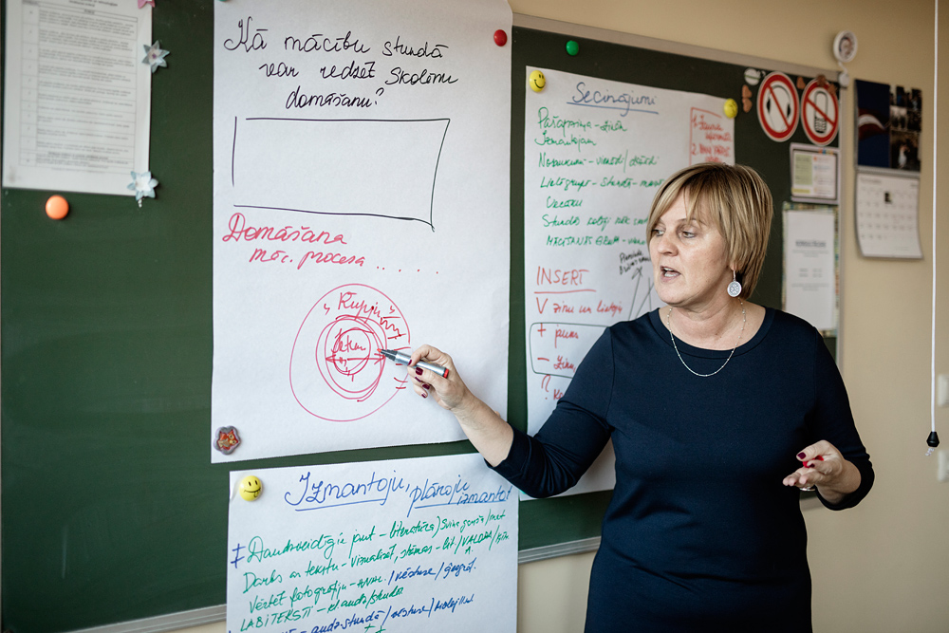
Teachers-consultants’ work in Latvia
2013-2015
Inga Pāvula
Ventspils
https://rebaltica.lv/2017/01/lemberga-kursos-japiedalas/

Slide 4
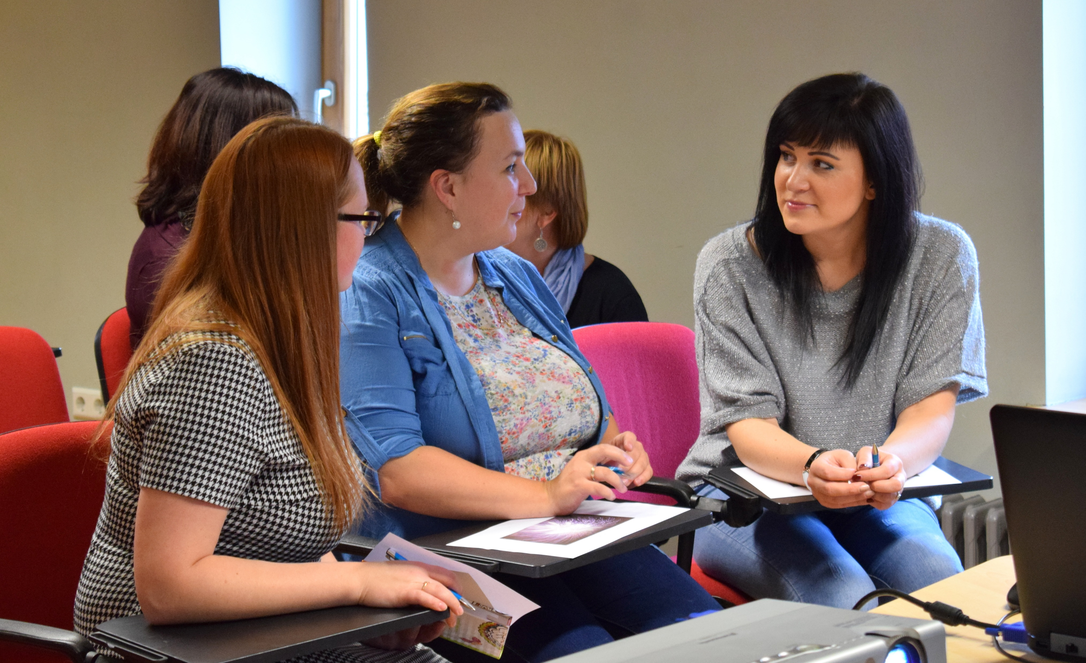
Teachers-consultants’ work in Latvia
Educational methodical service’s aim is:
to help and to support teachers to plan a modern lesson;
to identify and resolve educational problems with students at lessons.
https://vip.ventspils.lv/ventspili-noslegusies-jauno-skolotaju-atbalsta-programma/

Slide 5
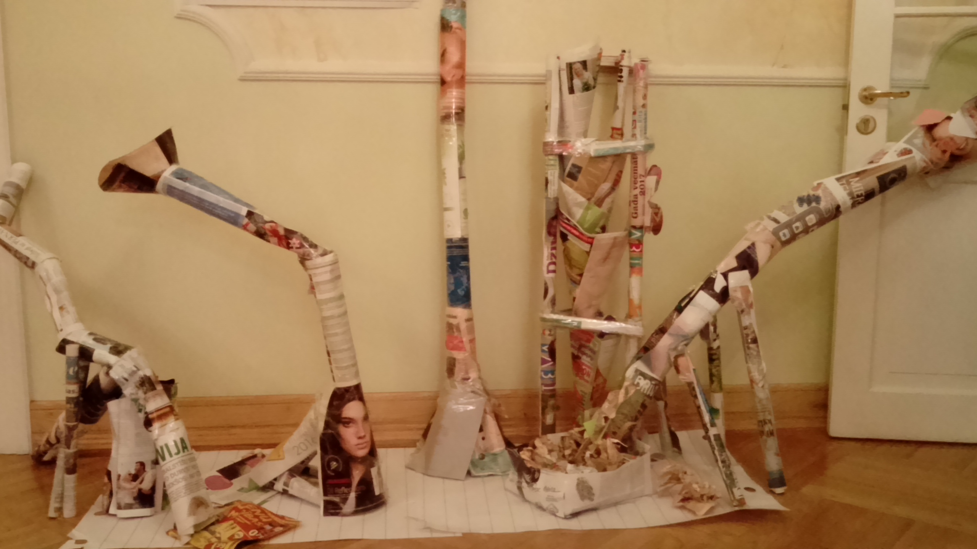
Teachers-consultants’ work in Latvia
2017
Inga Pāvula
Riga, RIIMC
Speaker’s foto

Slide 6
Teachers-consultants’ work in Latvia
Lesson’s transcription
Time
Teacher’s activities
Students’ activities
Notes

Slide 7
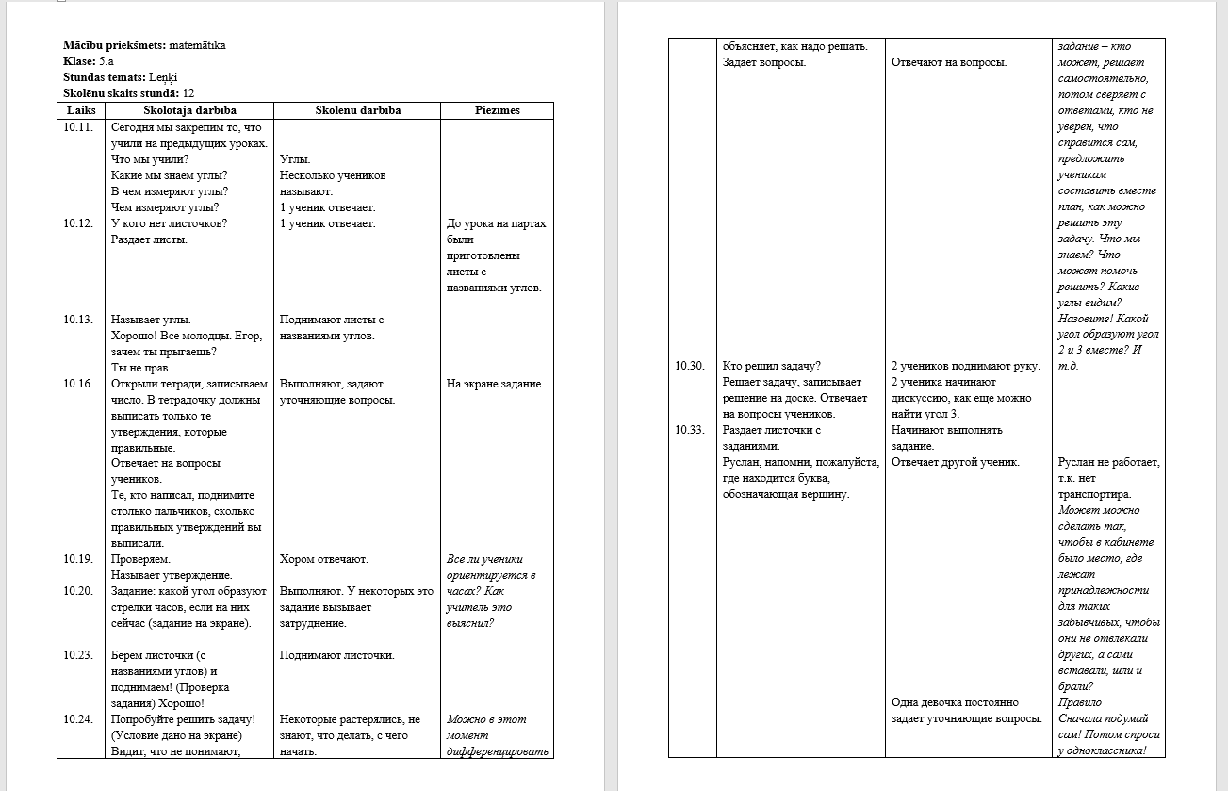
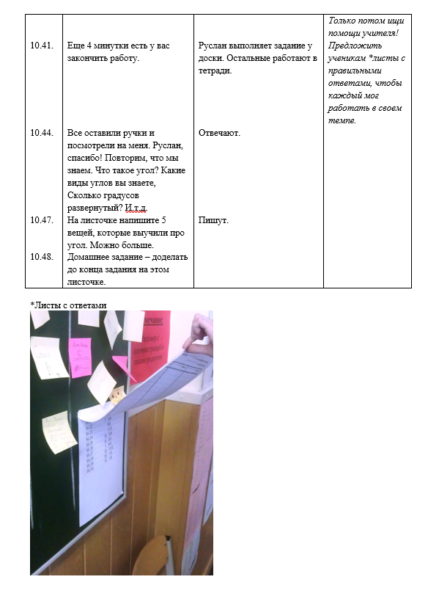
Teachers-consultants’ work in Latvia

Slide 8
Teachers-consultants’ work in Latvia
Effective feedback
time to speak with teacher about lesson,
effective, but not critique questions,
think about future lessons not about given;
don’t criticize myself – all mistakes help to improve teaching experience.

Slide 9
Teachers-consultants’ work in Latvia
2017
VISC
Latvija
https://www.facebook.com/SIIC.LU/photos/valsts-izgl%C4%ABt%C4%ABbas-satura-centrs-aicina-pieteikties-t%C4%81l%C4%81kizgl%C4%ABtot%C4%81ju-un-m%C4%81c%C4%AB%C5%A1an%C4%81s/445770989112118/

Slide 10
Teachers-consultants’ work in Latvia
VISC courses’ content
lesson’s elements (objectives for students’ learning, teaching/learning activities, strategies to check students’ skills, levels and motivation)
effective lesson planning;
the process of teaching and learning;
effective feedback.

Slide 11
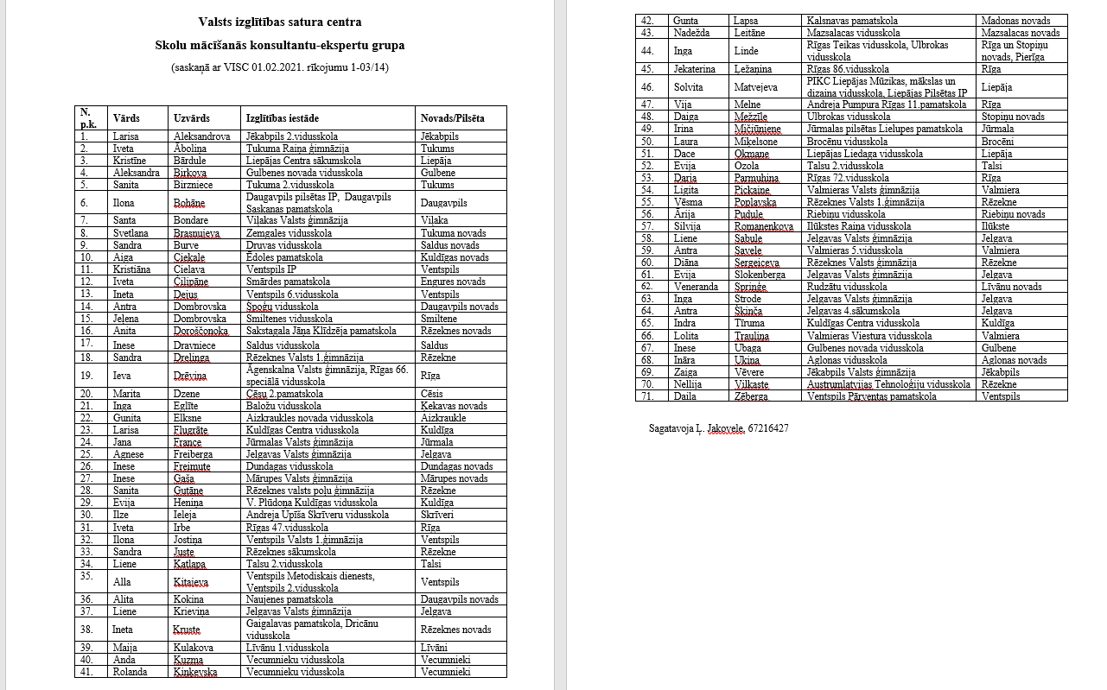
Teachers-consultants’ work in Latvia
Now in Latvia there are 71 teacher-consultants
https://www.visc.gov.lv/lv/media/13679/download

Slide 12
RIIMC teacher-consultants service system
1. A school headmaster or deputy head identifies problems. For example, a teacher has a problem with lesson planning or this teacher is working at school the first or second year.

Slide 13
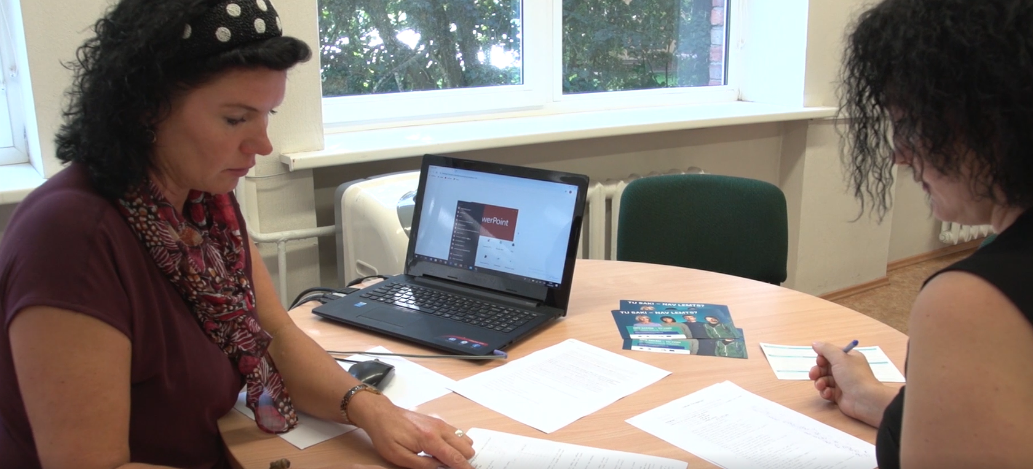
RIIMC teacher-consultants service system
2. A school headmaster or deputy head completes a form and sends it to a RIIMC specialist.
https://iksd.riga.lv/lv/rd-iksd/gallery/ridziniekiem-pieejamas-bezmaksas-karjeras-konsultacijas-292

Slide 14
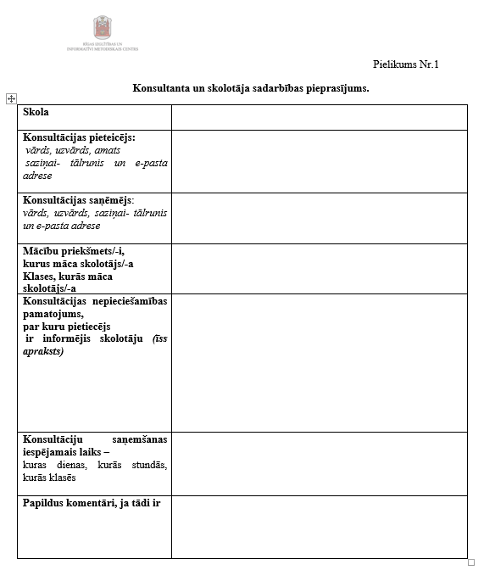
RIIMC teacher-consultants service system
2. A school headmaster or deputy head gives information about a teacher who needs a support in the form, for example, students’ age, difficulties, contact information.

Slide 15
RIIMC teacher-consultants service system
3. A RIIMC specialist sends the form to teacher-consultants – who of them wants to consult. Teacher-consultants are specialists at different school subject, some of them work at schools with the Latvian language of tuition, but some – with the Latvian and Russian languages of tuition. So, a teacher-consultant can decide if he is able or not to consult in this specific case.

Slide 16
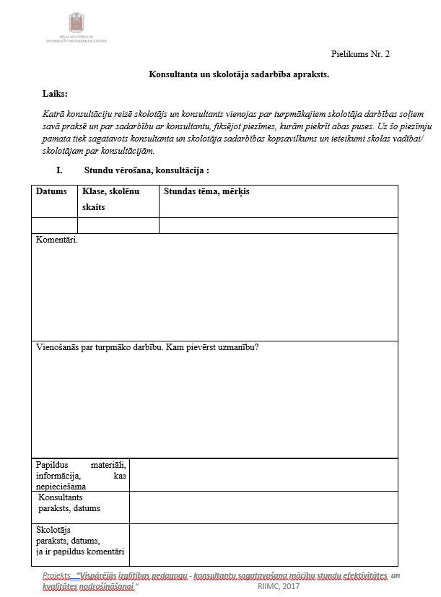
RIIMC teacher-consultants service system
4. A teacher-consultant contacts a teacher, speaks about his teaching experience and then observes lessons (at least 3 lessons). After each lesson the consultant gives feedback and completes forms (information about the lesson, for example, the date, form, the number of students, lesson’s topic, aim, comments, and prepare the list for the next time).

Slide 17
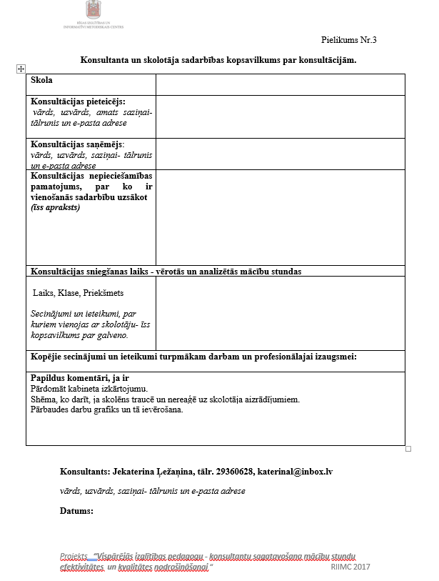
RIIMC teacher-consultants service system
5. A consultant completes forms about cooperation with the teacher for the school administration.

Slide 18
RIIMC teacher-consultants service system
6. After the last lesson the consultant talks to the teacher and school headmaster or deputy head, gives feedback. The aim of this conversation is to suggest some ideas to school administration how they can help and support the teacher.

Slide 19
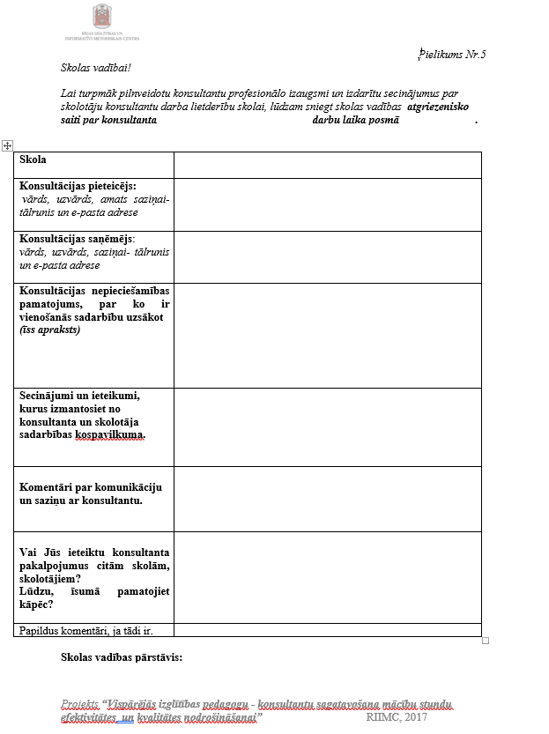
RIIMC teacher-consultants service system
7. This teacher, school headmaster or deputy head fill the forms of cooperation with consultants – give feedback to teacher-consultant.

Slide 20
RIIMC teacher-consultants service system
8. All forms are sent to RIIMC specialist.

Slide 21
Experience and challenges
To understand the true aim of school administration.
The teacher is very interested in cooperation and uses all ideas which I suggested.
The teacher don’t want to change anything in his pedagogical practice.

